Slide 1
Engaging Learners in Citizen Science Data Exploration: A Focus on Climate-Related Citizen Science Initiatives

Slide 2
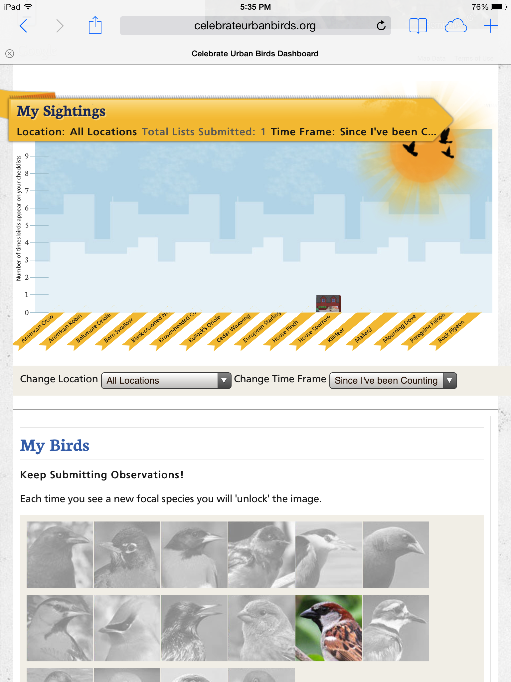
Team Reflection
With your team, discuss: What did you learn from the citizen science data collection experience?
Consider this question from the perspective of yourself as a learner and as a teacher

Slide 3
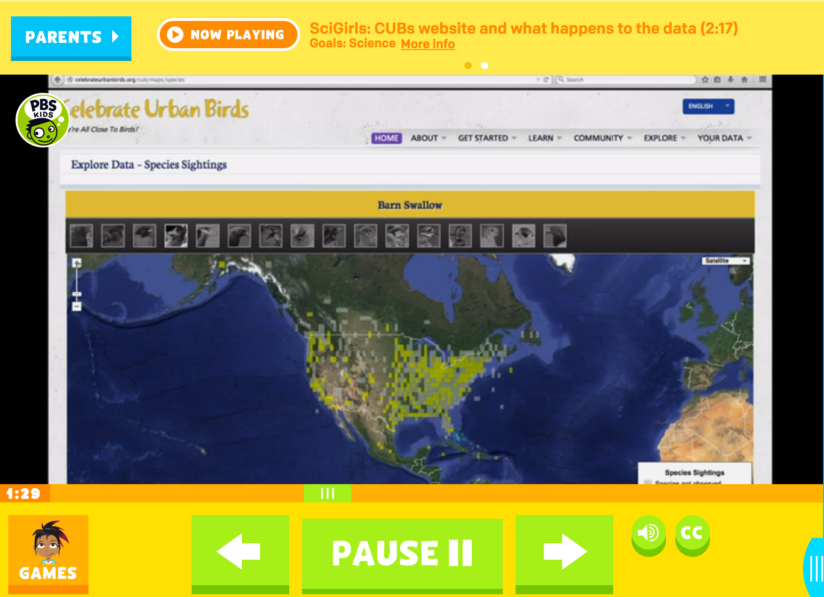
What happens to the data?
Video: http://pbskids.org/scigirls/videos/nature-nurture (select: CUBs website and what happens to the data)

Slide 4
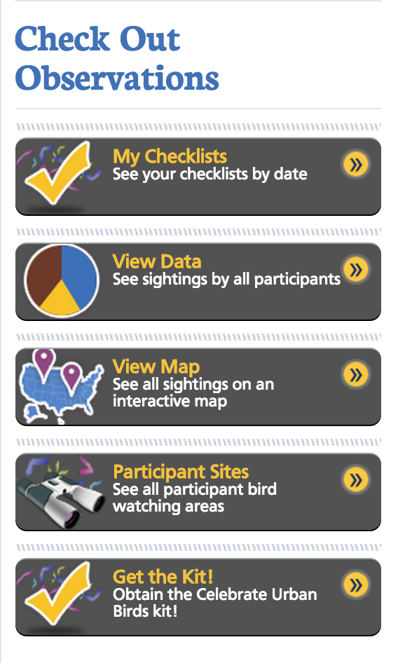
Exploring the larger dataset
Go to the Celebrate Urban Birds data dashboard (on iPad or on your laptop)
Our key question: What stories are the data telling?

Slide 5
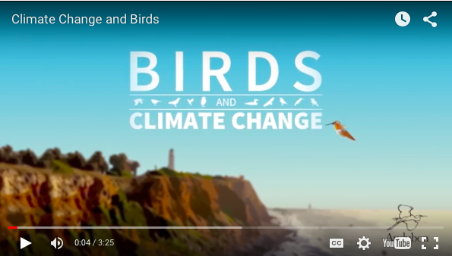
What stories are the data telling about real-world science topics?
Examining changes over time:
A climate change example: According to National Audubon Society’s Birds and Climate Change report (2014), citizen science data suggest there have already been changes in the ranges, migratory patterns, and abundance of bird species that correlate with changes in climate conditions. This can help scientists predict how such trends may continue in the future.

Slide 6
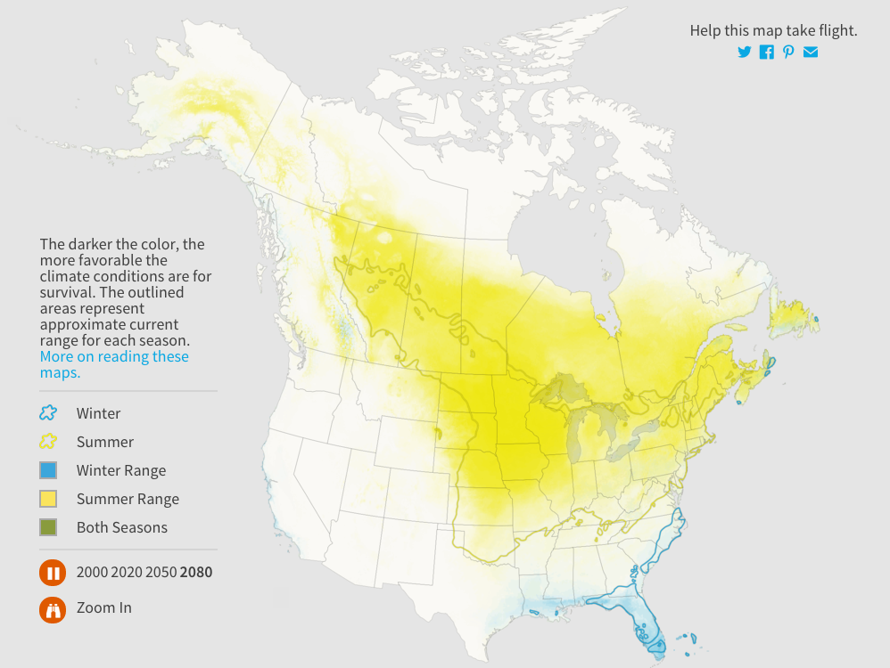
What stories are the data telling about real-world science topics?
Examining changes over geographic space
Example: Based on citizen science data collected over a broad geographic area, scientists can create models that predict where species’ ranges may shift in the future given changes already being observed
http://climate.audubon.org/birds/balori/baltimore-oriole

Slide 7
How could citizen science help you engage your students with data related to the topics in your science curriculum?
Your task:
On your own or with a partner who teaches at your grade level, take a guided tour (posted online) of a citizen science project that connects with a science topic taught at your grade level. You will have ~15 minutes.

Slide 8
How could citizen science help you engage your students with data related to the topics in your science curriculum?
Citizen science project | Journey North (observing butterfly migration) | Project BudBurst (observing seasons and plants) | CoCoRahs (observing precipitation)
Possible 1st grade Topics | Environmental issues | Environmental issues Diversity of life | Water cycle Interactions between atmosphere and hydrosphere
Possible 2nd grade topics | Environmental issues Ecology | Environmental issues | Interactions between atmosphere and hydrosphere
Possible 3rd grade topics | Seasons Environmental issues | Seasons Environmental issues | Water cycle
Possible 4th grade topics | Ecology | Slow changes, rapid changes Celestial bodies, celestial patterns | Water cycle
Possible 5th grade topics |  | Slow changes, rapid changes Celestial bodies, celestial patterns Classification | Water cycle

