Slide 1
Engaging Learners
in Citizen Science
Data Collection
A Focus on Birds and Climate

Slide 2
Pre-activity Review
In preparation for today, you engaged with an informal science education resource: an episode of the PBS Kids show, SciGirls.
Video clip (3:49): http://pbskids.org/scigirls/videos/nature-nurture
(Select video labeled “Bird Watching”)

Slide 3
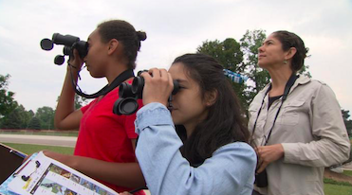
Small group discussion
In the SciGirls episode, the girls collected and reported observational data about local bird populations that would be used by professional research scientists.
What do you think your students could gain from this kind of science learning experience?
What makes this approach to science engagement unique?
Image from www.pbslearningmedia.org

Slide 4
What is Citizen Science?
Citizen science is public involvement in scientific research activities in collaboration with the scientific community; also called public participation in scientific research (PPSR) (Bonney et al., 2009)
Citizen science has expanded and evolved with widespread public access to Internet and mobile devices (Devisch & Veestraeten, 2013)

Slide 5
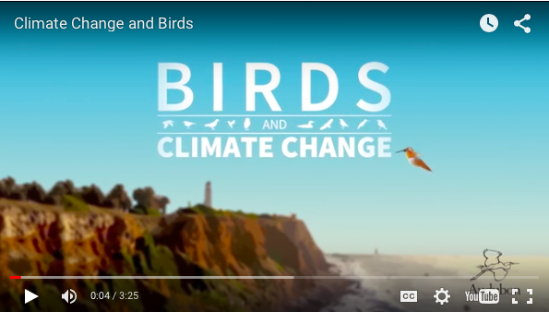
How are data used?
Example:
National Audubon Society’s Birds and Climate Change report (2014)
Video: http://climate.audubon.org/article/audubon-report-glance
Notes:
The National Audubon Society has completed a continental analysis of how North America’s birds may respond to future climate change. Using extensive citizen science data… we developed models that characterize the relationship between the distribution of each species and climate. Then, we used our models to forecast species distributions to future time periods.
(National Audubon Society, 2014)
Benefits for science community:
Data collected over broad geographic area
More data collected in less time
Benefits for participants:
Positive attitudes toward science
New science-related knowledge
Coming to see oneself as a “science person”

Slide 6
Small group discussion
Based on what you understand about the Celebrate Urban Birds project:
What would your students need to know how to do in order to collect and report accurate data?
What advance preparation would you, as a teacher of science, need to do to get students ready?

Slide 7
Let’s try it!
Your group’s task:
Choose an outdoor site on campus to collect data.
Conduct observations for 10 min. following the Celebrate Urban Birds data collection protocol (see data sheet)
Use your iPad to report your data to the Celebrate Urban Birds online database (see instructions on the next few PPT slides)
Repeat at another observation site if you have time.

Slide 8
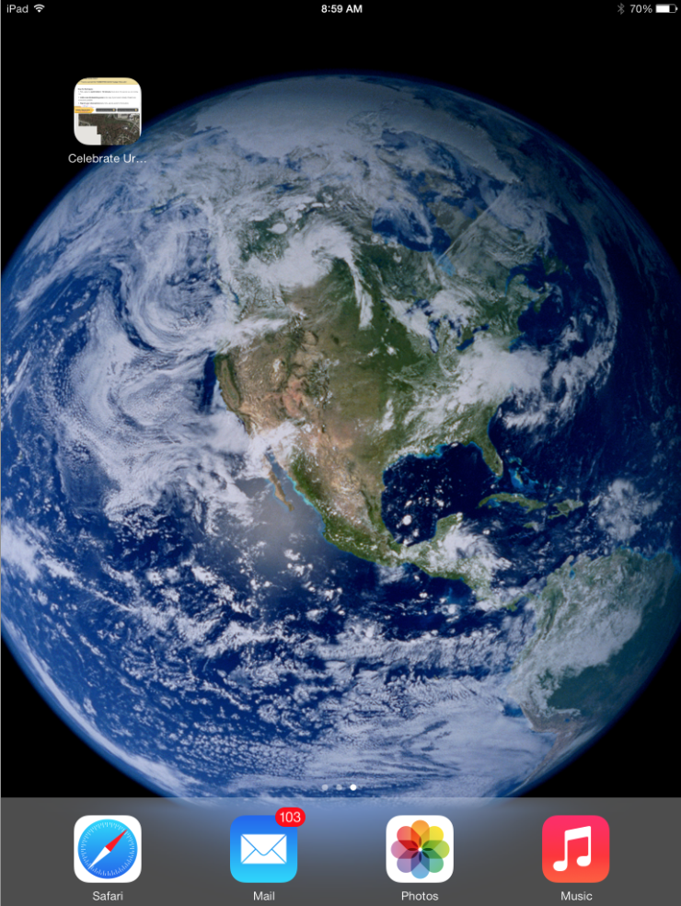
Reporting your data
Select the Celebrate Urban Birds icon on your iPad (it should automatically log you in to an account for reporting data).*
*make sure you are connected to wifi

Slide 9
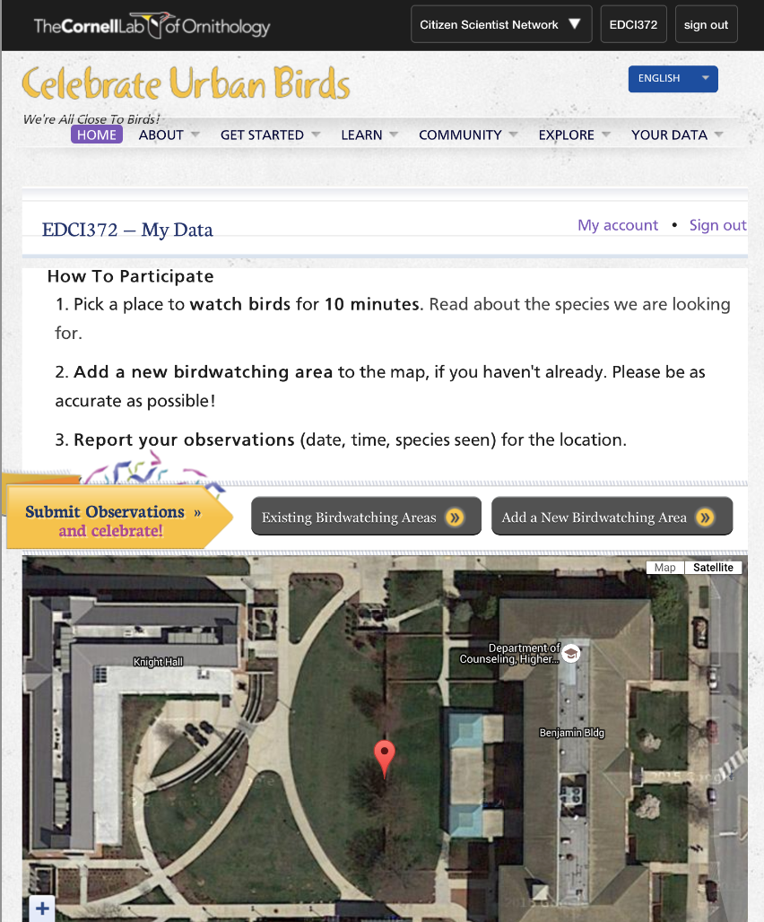
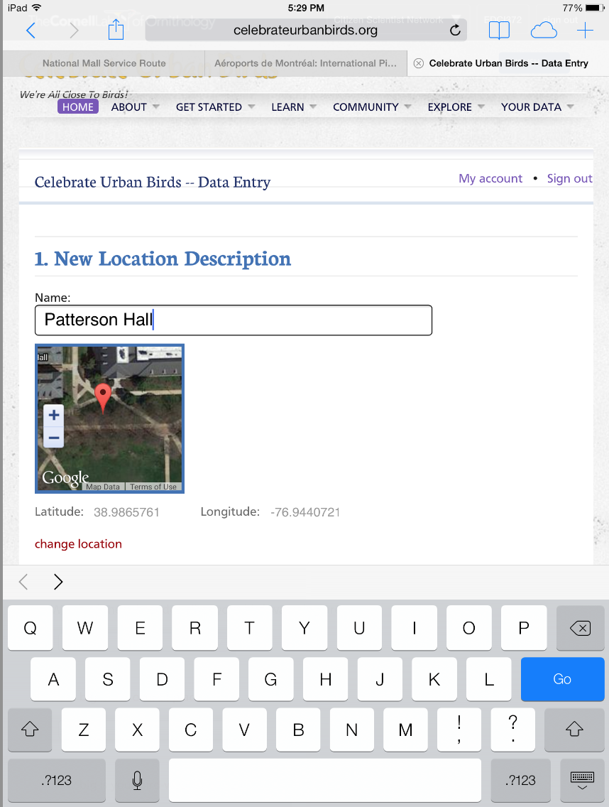
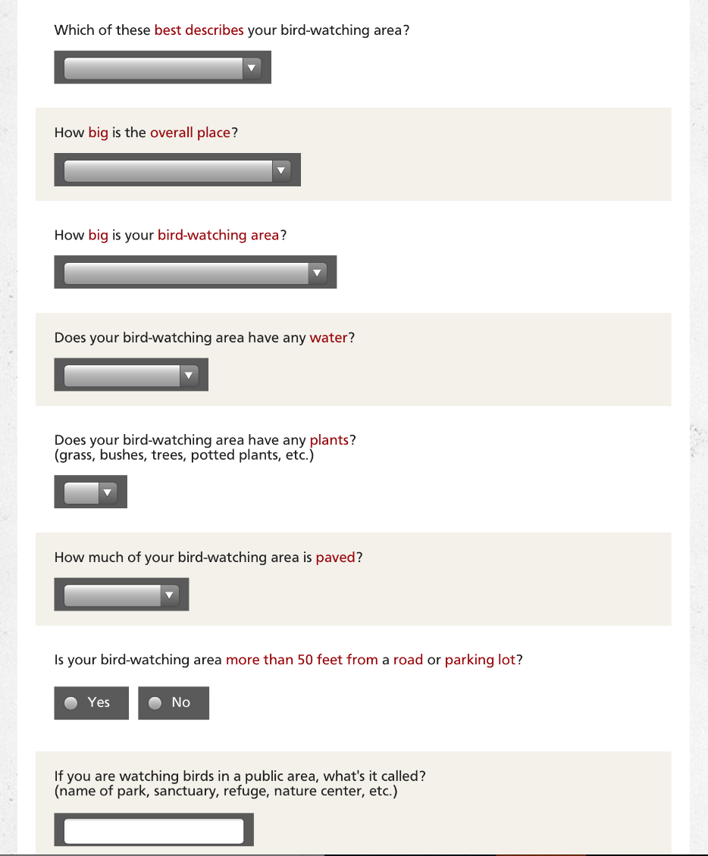
Reporting your data
Select “Add a new birdwatching area” and answer questions about your location.

Slide 10
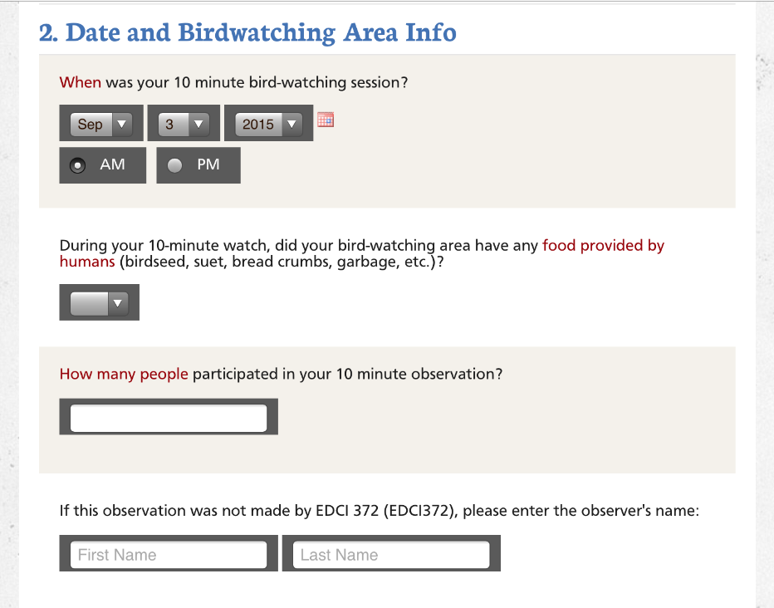
Reporting your data
Record the date and requested birdwatching area info

Slide 11
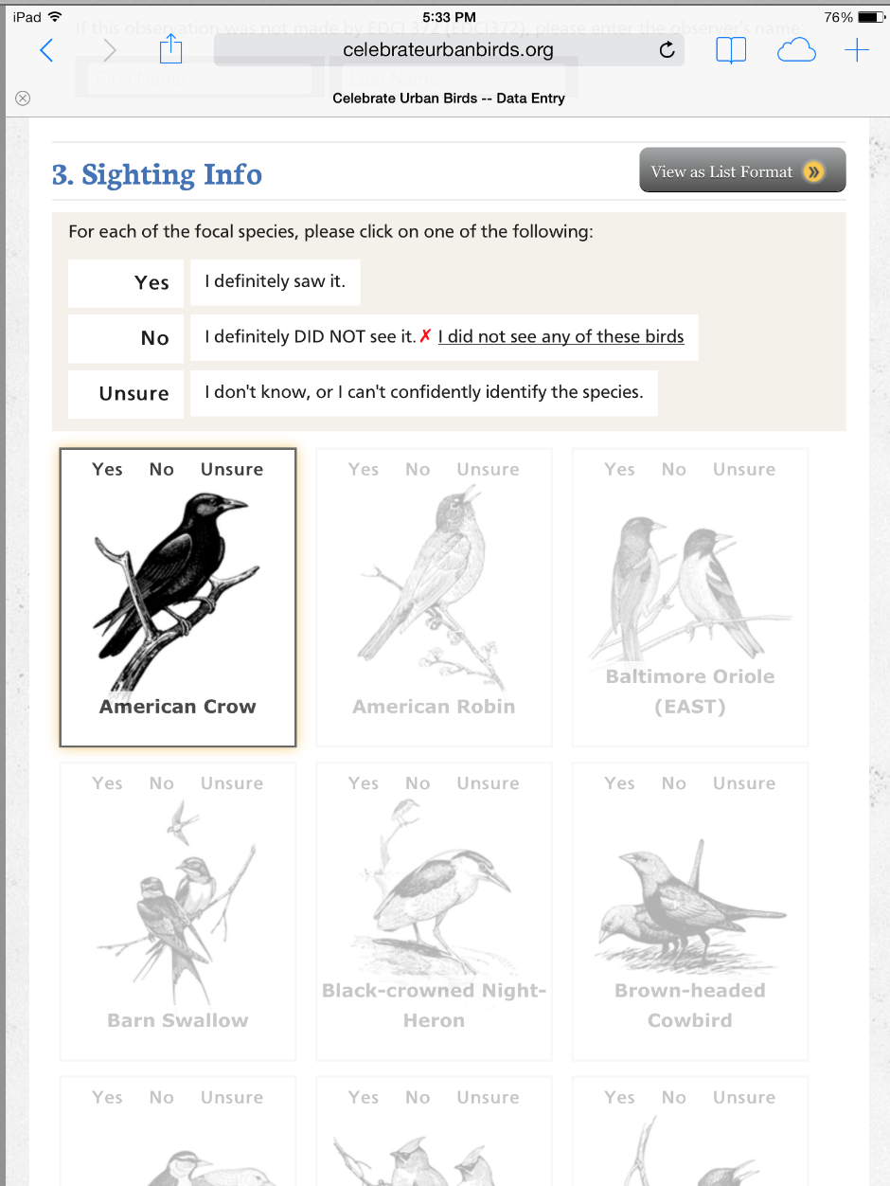
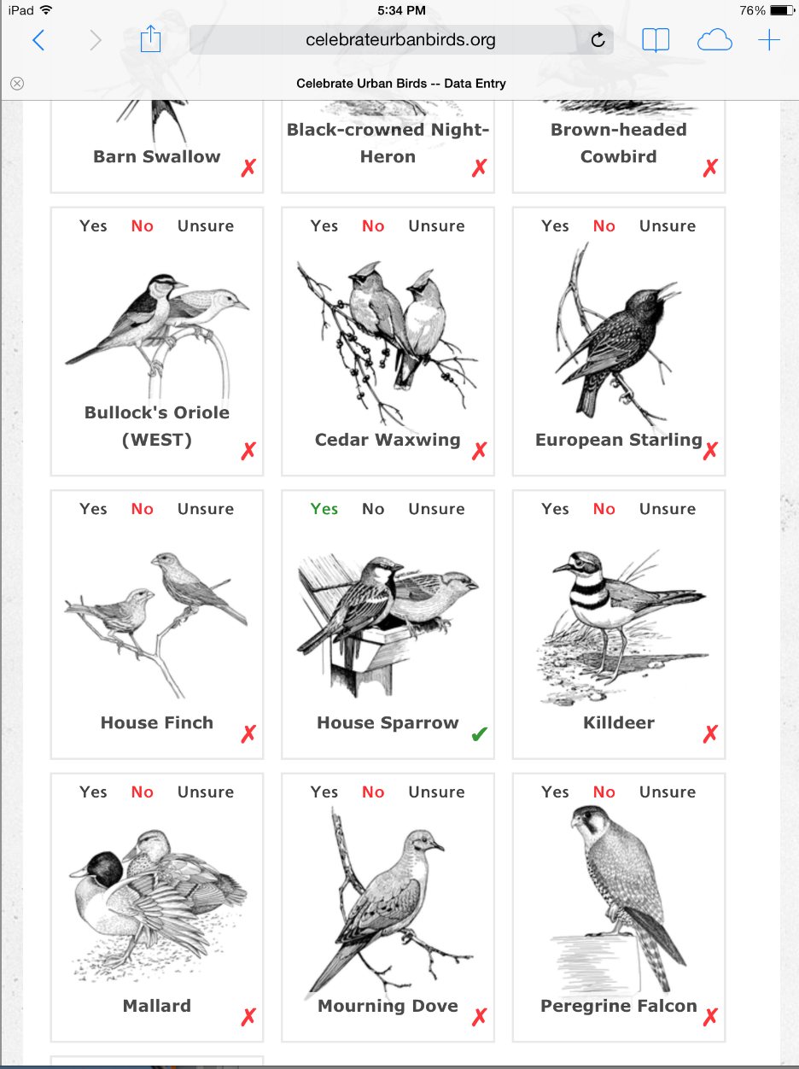
Reporting your data
Record your bird sighting info. For each of the 16 species, indicate Yes, No, or Unsure.

Slide 12
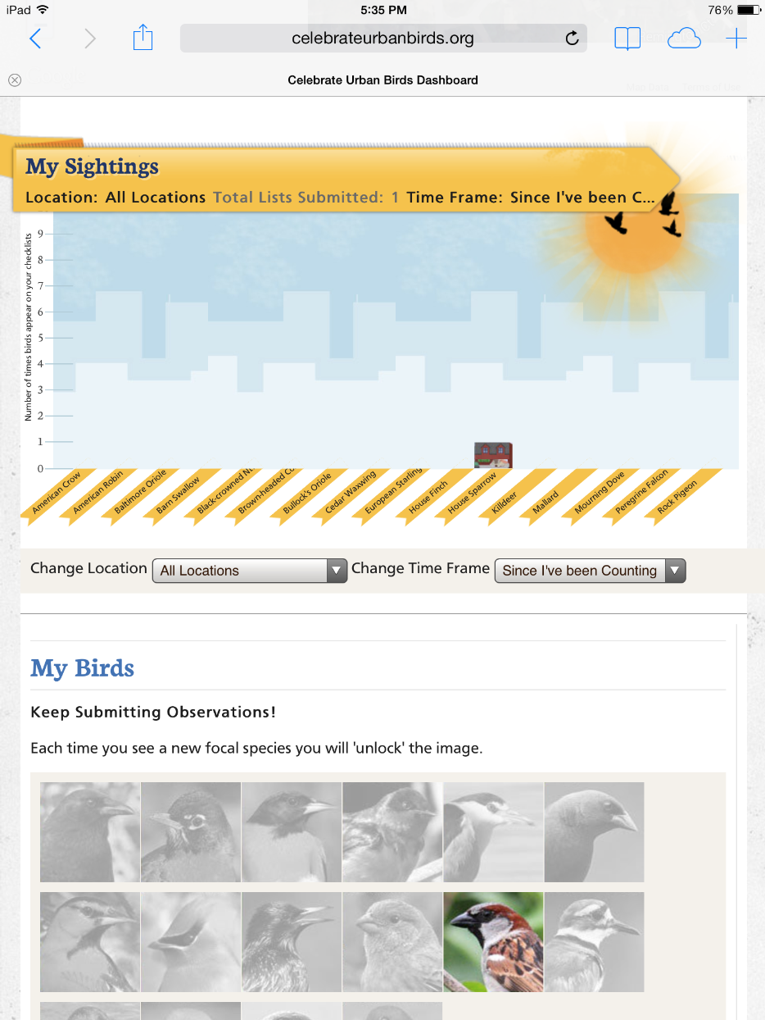
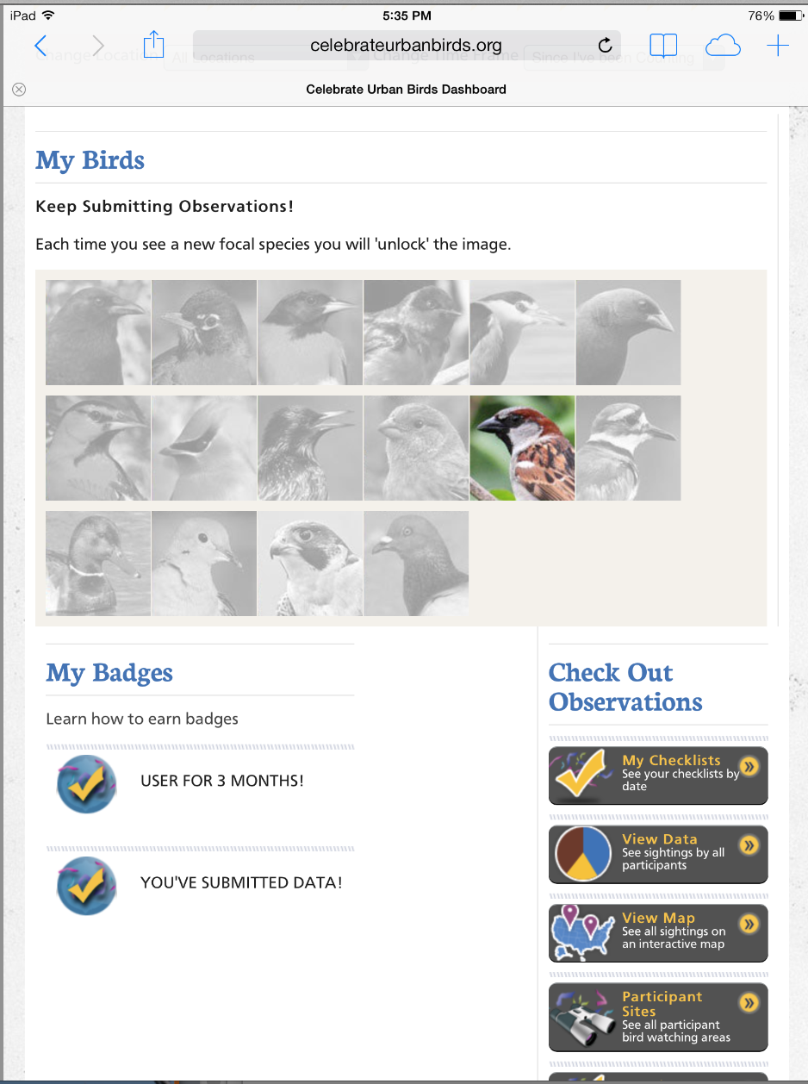
Reporting your data
Submit your data!

Slide 13
Have fun!
At the end of the class period, please have one representative from your group find me in the classroom to return your team’s materials.
Raven image from: http://www.copyright-free-images.com/fauna-animals-copyright-free-images/birds-copyright-free-images/ravens-and-crows-free-images/raven-sitting-on-end-of-branch.jpg.html

